Slide 1
Enumeration
Name Tesfaldet Weldemicheal
Tryhackme account : wete25kq@student.ju.se
Group: 5
Student:6
Topic: Enumeration

Slide 2
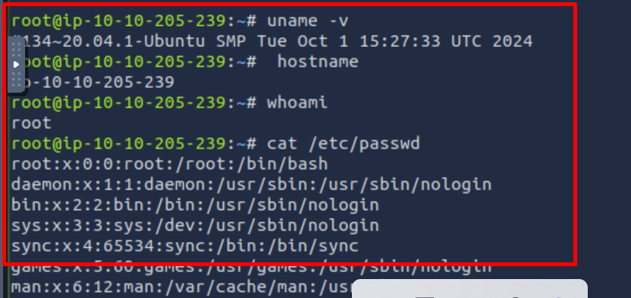
Linux Enumeration
Post-exploitation enumeration involves gathering system and network data to better understand a compromised environment.
It typically occurs after gaining shell access to a system, where specific information such as user groups, hostnames, routing tables, network shares, services, applications, and firewall configurations is sought.
Other potential findings include SSH keys for accessing other systems and sensitive user data like stored passwords in documents. This process is crucial for moving laterally through networks or escalating privileges on the current system.

Slide 3
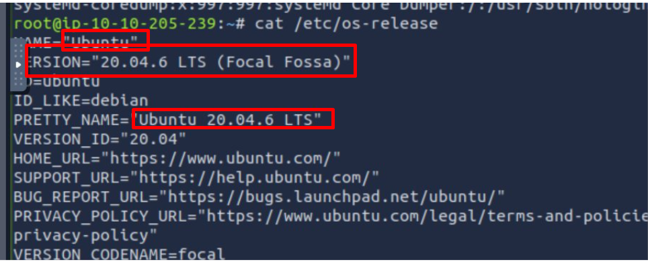
Linux Enumeration
By running the command as you can see in the screen shoot.
This gives us most detailed information about the distribution name and version

Slide 4
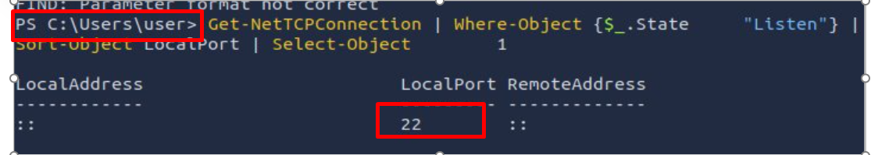
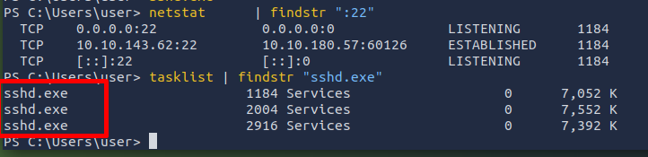
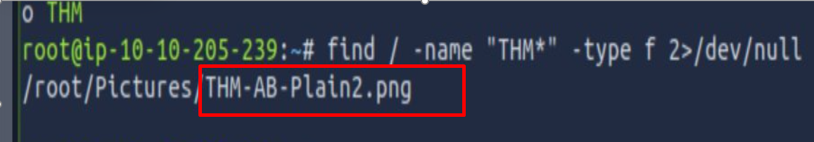
As visible in the screenshot:
ps aux | grep THM` - The quickest method to find running processes by name.
`ssh` - Enables secure connections to remote servers.
sshd.exe running, it means the windows machine is configured to accept remote SSH connections

Slide 5
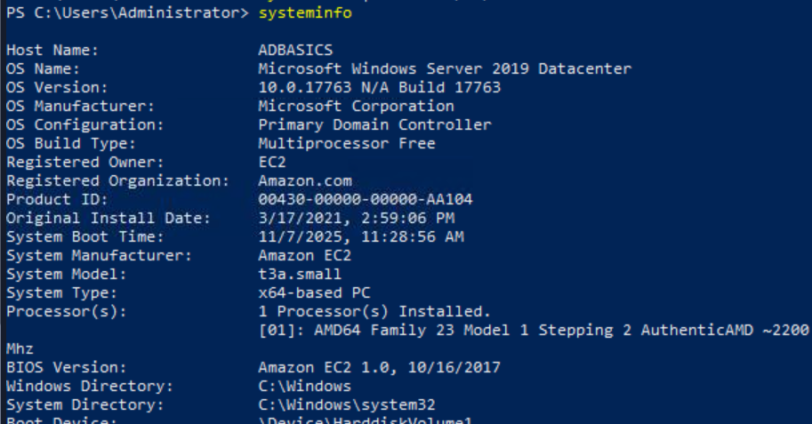
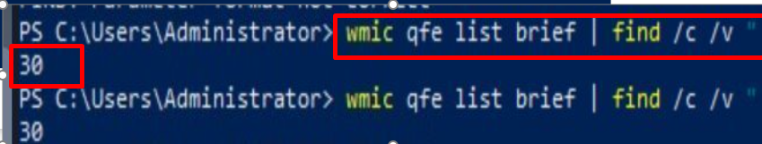
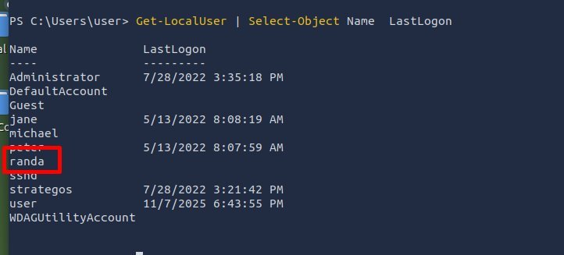
Windows Enumeration
systeminfo Command:
Shows: Complete system configuration details
Reveals: OS version, install date, hardware specs, domain role
Key Finding: This is a Windows Server 2019 Domain Controller
wmic qfe list brief | find /c /v "" Command:
Shows: Count of installed Windows updates/hotfixes
Reveals: Total number of security patches and updates applied
Key Finding: 30 hotfixes installed on this system

Slide 6
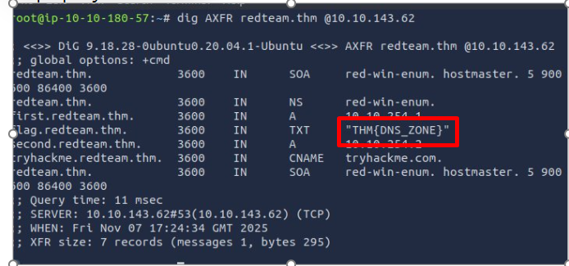
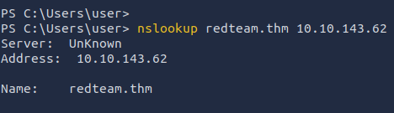
DNS, SMB, and SNMP
Query DNS records (A, AAAA, CNAME, TXT) to discover network information
Attempt DNS zone transfers using dig -t AXFR example.com @192.168.1.100
As the pic shows the domain transfers can reveal hidden hosts if not properly restricted

Slide 7
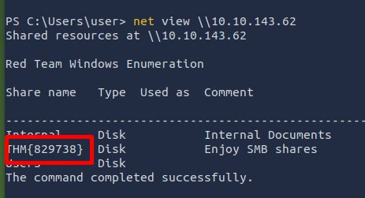
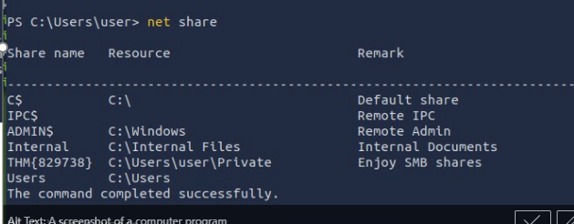
SMB
Server Message Block protocol for file/printer sharing
Discover shared resources using net share
As you can see in the pic this identifys accessible folders and network resources

Slide 8
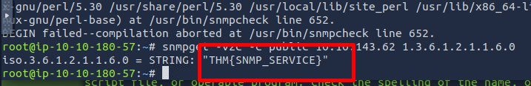
SNMP
Simple Network Management Protocol for device management
Can expose system information and network data
AS task indicates it check for public community strings and accessible MIB data

Slide 9
More Tools for Windows
Process Explorer focuses on processes and their resources
Process Monitor real-time monitoring tool
PsList process information
PsLoggedOn specifically mentions "Shows the logged-in users"
PsService service management
No lab in this section

Slide 10
Observations of seminar sessions
During the presentation, I found that the material was largely familiar, as I had already studied all the topics prior to the seminar. The presentations by my colleagues also covered the same concepts I was already familiar with.
I did not encounter any concepts that I thought I understood but later discovered were incorrect.
Previously known techniques that were validated includes such Burp Suite, Enumerating Users via Verbo, Authentication Enumeration, Enumerating Users via Verbose Errors, Credential Injection, and Enumeration through Command Prompt

Slide 11
General Information
This assessment focused on Linux and Windows system enumeration techniques using built-in command-line tools to gather critical system information, security posture details, and network service configurations on the attack box
Key Takeaways from Tools and Techniques:
The commands provide comprehensive system intelligence
Systeminfo reveals OS configuration, domain role, and system specifications
wmic commands access deep system data including hotfixes and user accounts
Network enumeration identifies listening services and potential attack surfaces
Proper tool selection enables efficient security assessments
Execution Methodology:
Utilized Command Prompt and PowerShell for all enumeration
Applied filtering techniques with findstr and find commands
Implemented sorting and counting methods for data analysis
Verified results through multiple command approaches

Slide 12
Task Outcomes
Identified such Windows Server 2019 Domain Controller configuration
Documented 30 installed security hotfixes
Mapped all listening TCP services and associated applications
Compiled comprehensive user account and login history
Established baseline system profile for security monitoring
Demonstrated effective enumeration using only native
Windows tools
The assessment confirmed that robust system enumeration can be performed entirely with built-in utilities, providing essential data for security hardening and compliance verification.

